Slide 1
EULER’S method & MODIFIED EULER’S METHOD
By
Doyel Sarkar

Slide 2
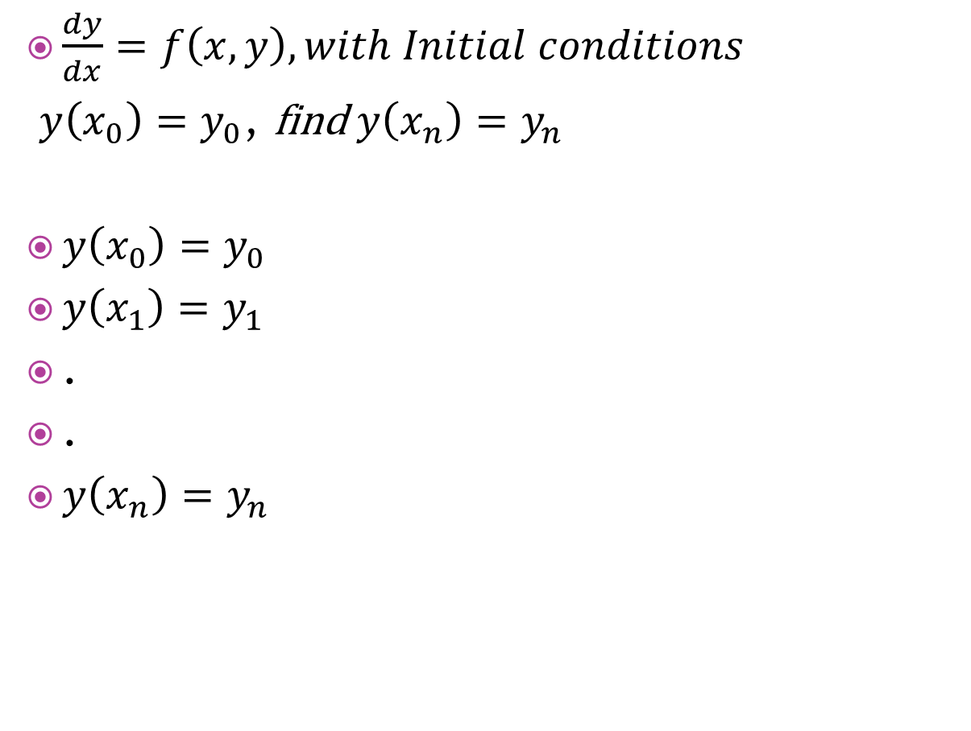
EULER’S Method
$\frac{dy}{dx}=f\left(x,y\right), with Initial conditions$
$y\left(x_{0}\right)=y_{0}$, find $y\left(x_{n}\right)=y_{n}$
$y\left(x_{0}\right)=y_{0}$
$y\left(x_{1}\right)=y_{1}$
.
.
$y\left(x_{n}\right)=y_{n}$

Slide 3

Working Formula
Formula

Slide 4

Example1
Compute $y(0.4)$ from the equation
$\frac{dy}{dx}=xy+y^{2}$ given that $y\left(0\right)=1$

Slide 5
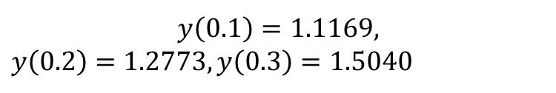
$$y\left(0.1\right)=1.1169,$$
$y\left(0.2\right)=1.2773,y\left(0.3\right)=1.5040$

Slide 6
MODIFIED EULER’S METHOD

